Slide 1

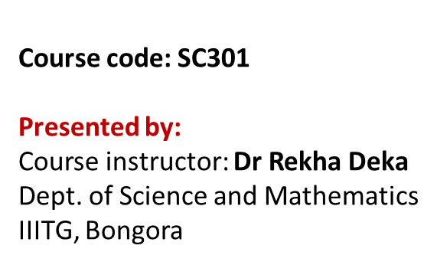
UNIT V - BIOSENSOR
Basic set up, Working principle, Types and its applications

Slide 2
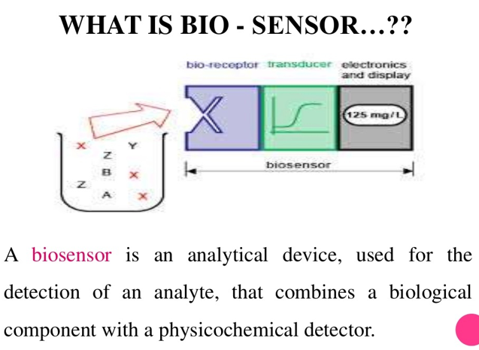
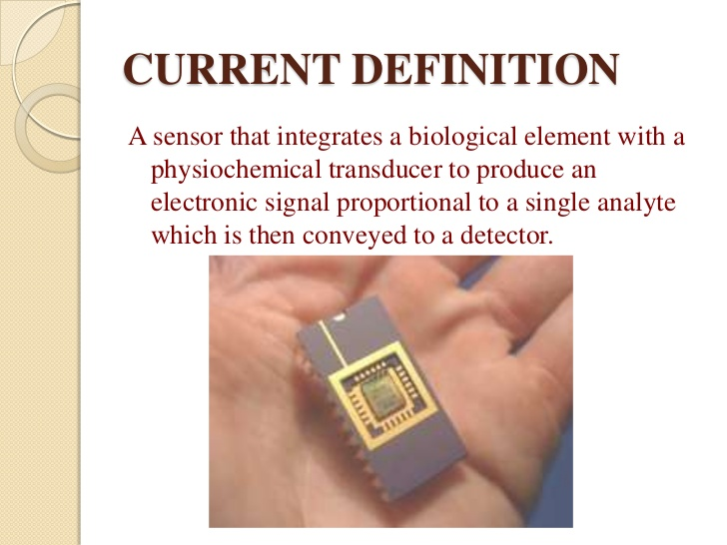

Slide 3
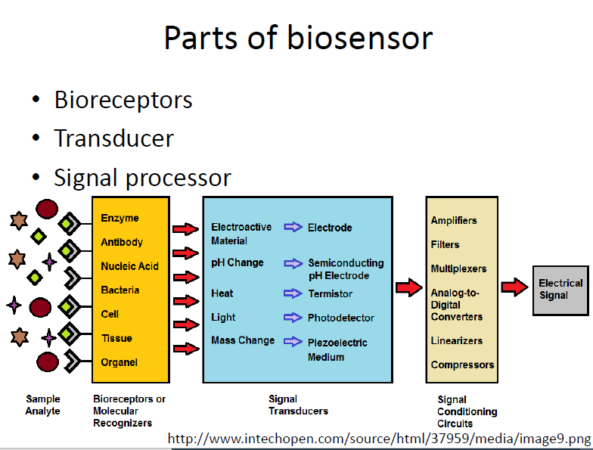
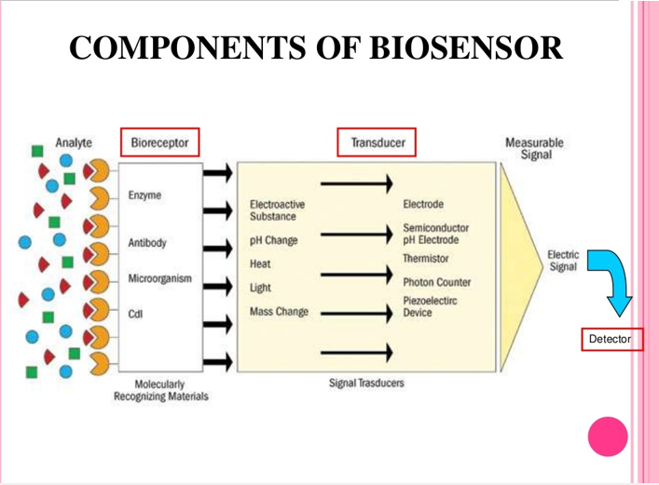
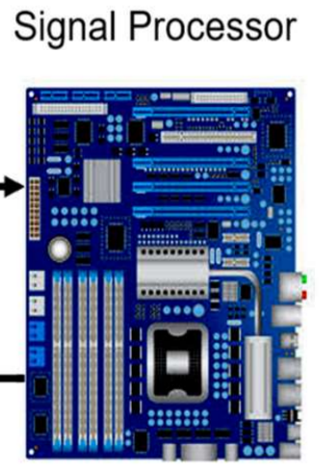
Thermistor

Slide 4
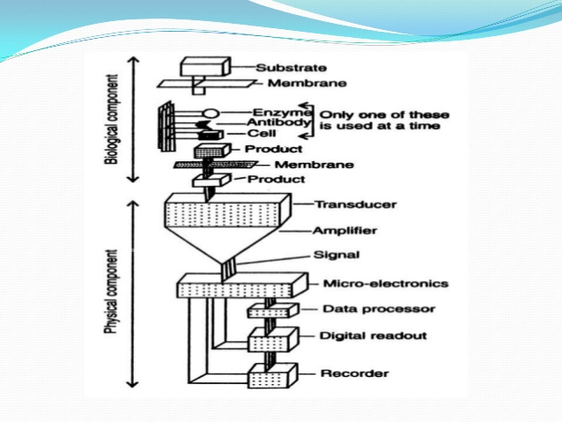
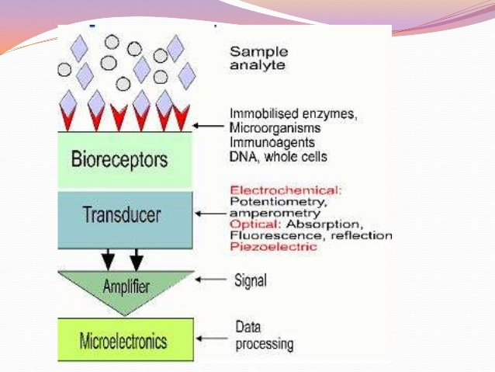
Basic set up of Biosensor

Slide 5
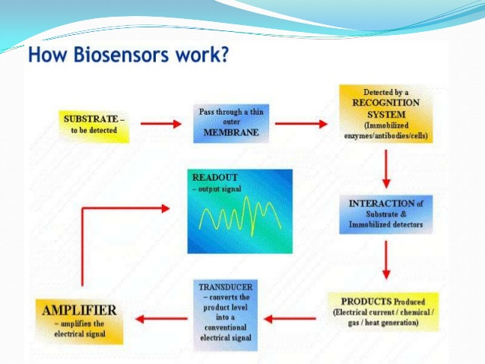

Slide 6
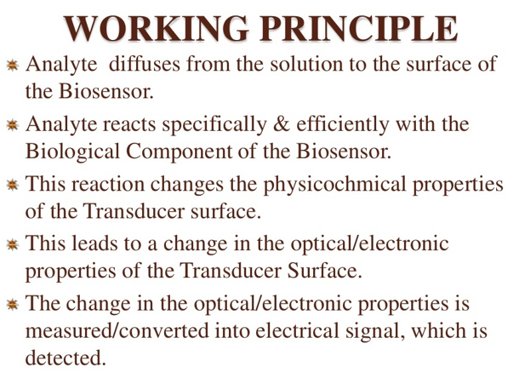

Slide 7
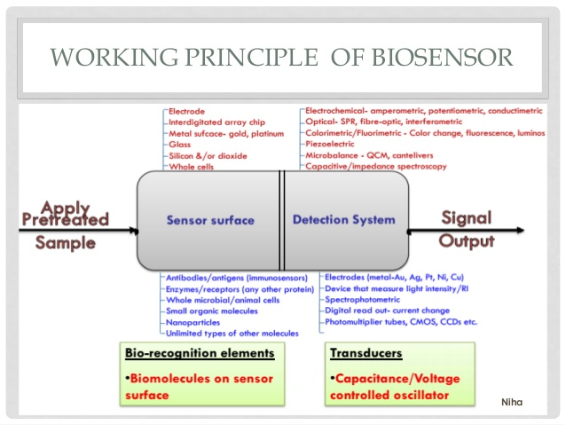

Slide 8
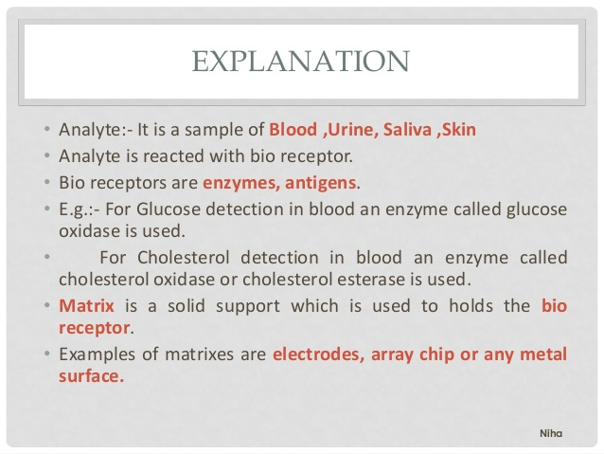

Slide 9
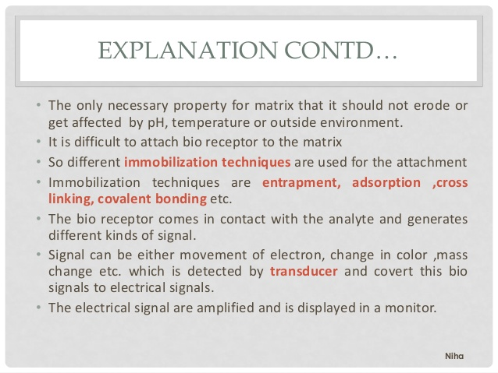

Slide 10
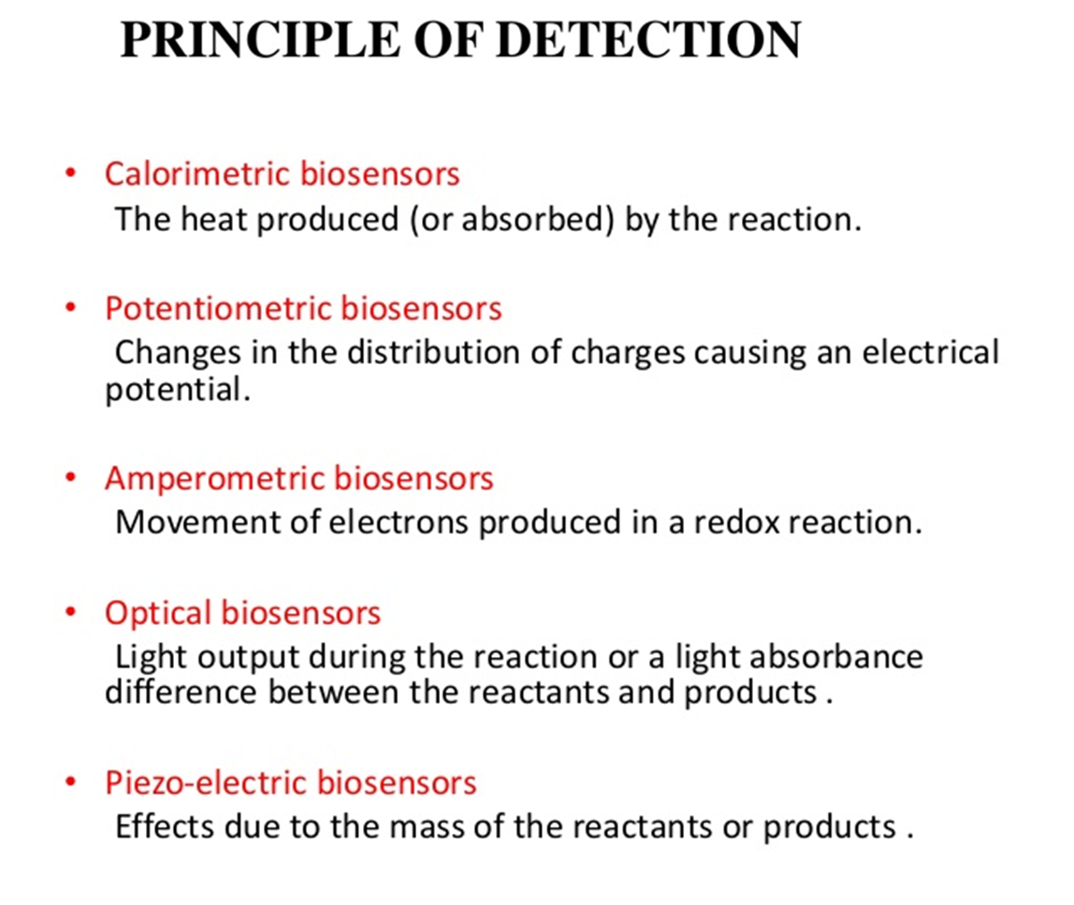
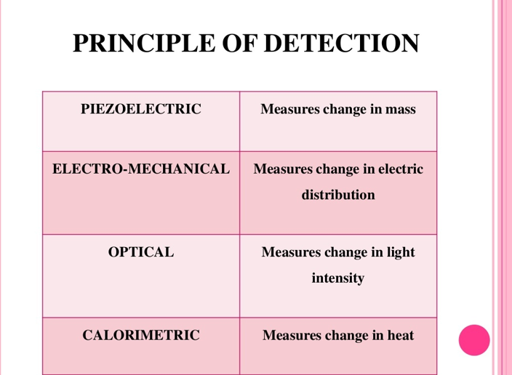
Measures change in electrical potential
Measures current

Slide 11
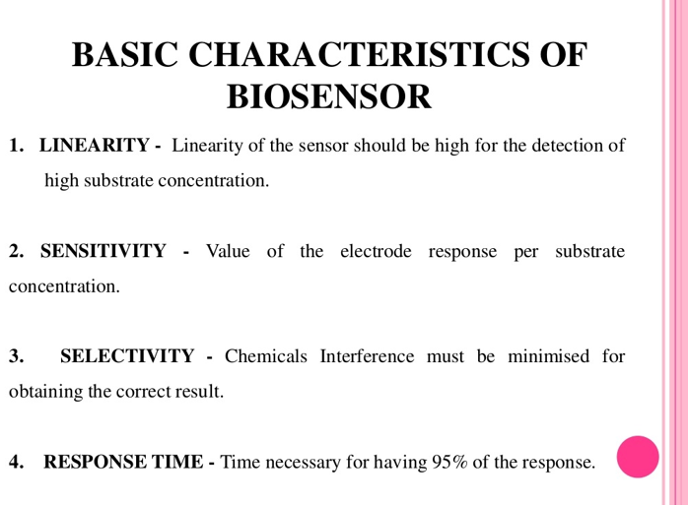

Slide 13
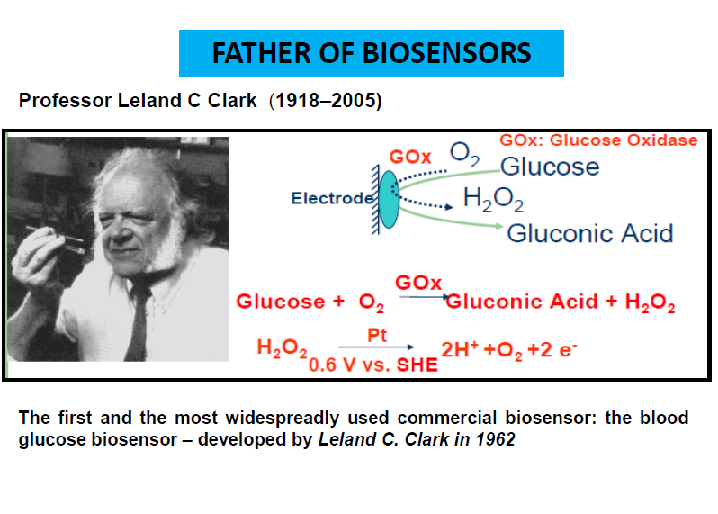

Slide 14
BIOSENSOR

Slide 16
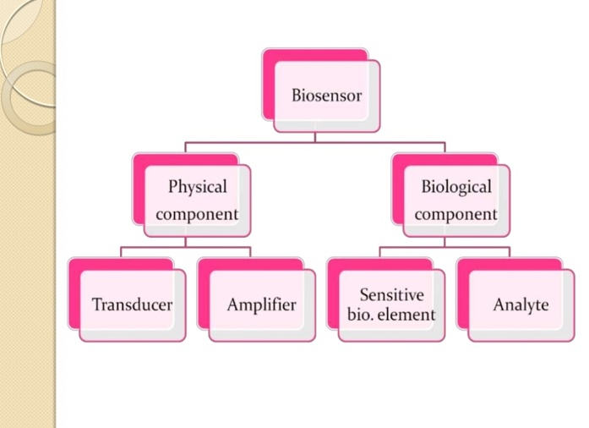
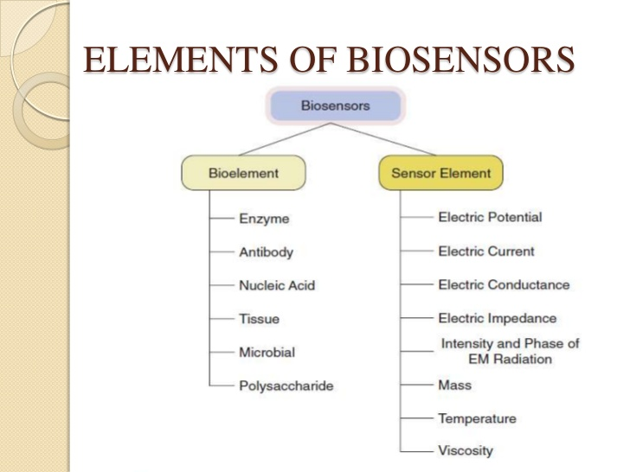

Slide 17
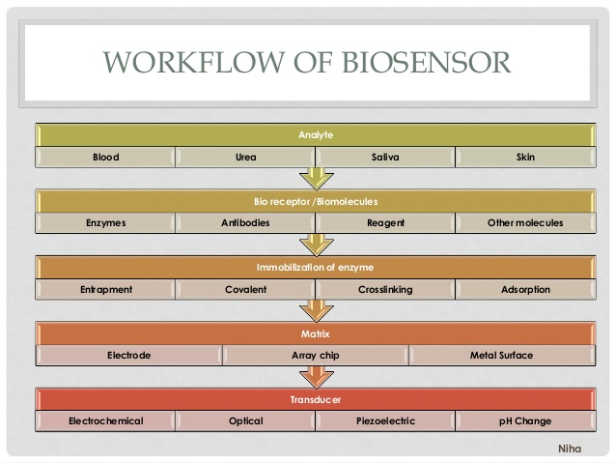

Slide 18
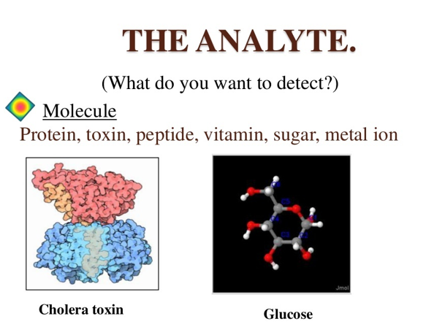
What do you want to detect?

Slide 19
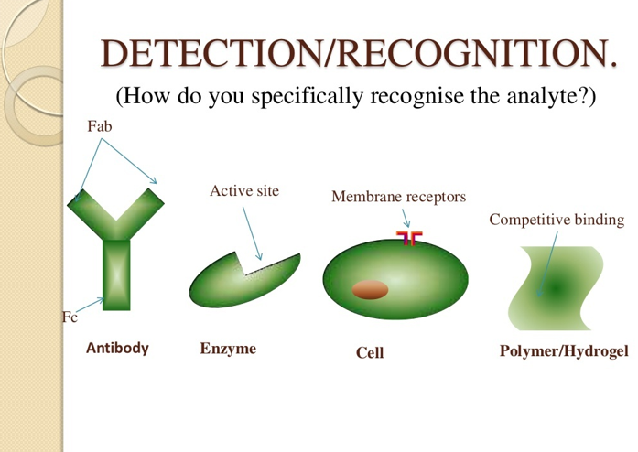

Slide 20
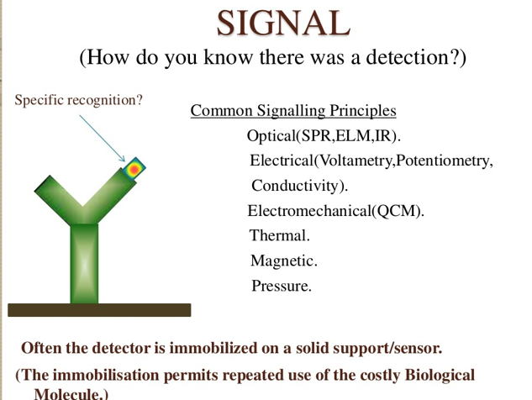

Slide 21
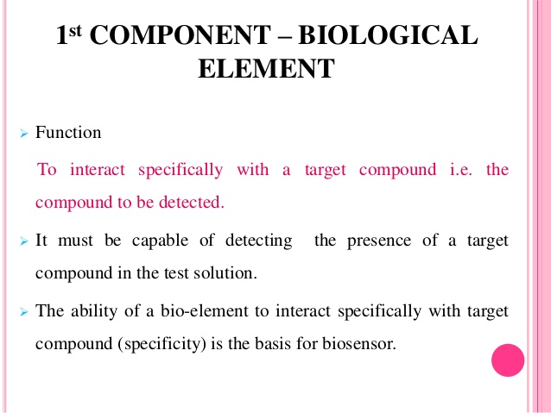
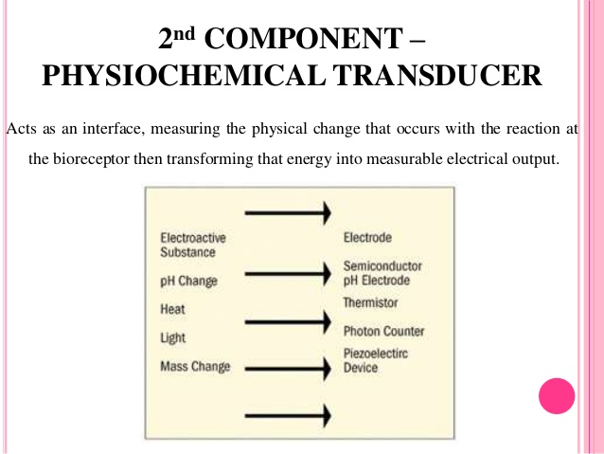
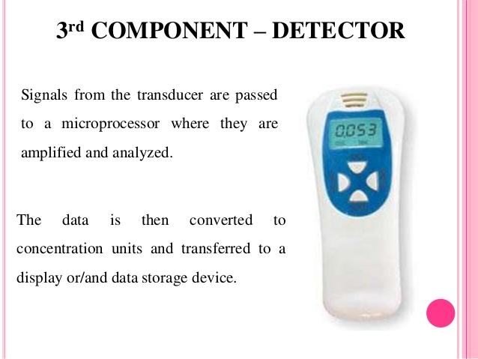

Slide 22
1. Optical biosensor: It uses optical devices that can transform the changes of optical phenomena due to the interaction of the analyte with the receptor. The optical phenomena that takes place during the interaction.
Absorbance
Reflectance
Luminescense
Fluorescesce
Refractive index
Opto-thermal effect
Light scattering
2. Electrochemical biosensor: It uses electrochemical devices that will transform the effect of electrochemical interaction of an analyte and an electrode into a useful signal
……..Amperometric….current is measured in d.c or a.c mode
……..Potentiometric…..potential of the indicator electrode is measured against the reference electrode.
…..Conductometric and impedimetric uses electrical devices to detect the change in electrical properties caused by the interaction of bioreceptor with analyte.
3. Piezoelectric biosensor: uses mass sensitive devices to detect the change in mass at a specifically modified surface into a change of a property of the support material.

Slide 23
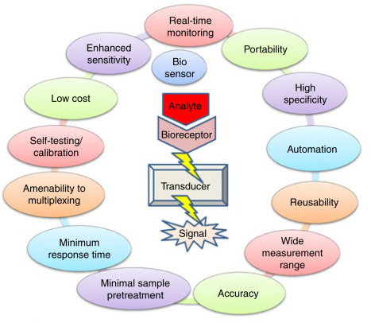
Successful Biosensor

Slide 24
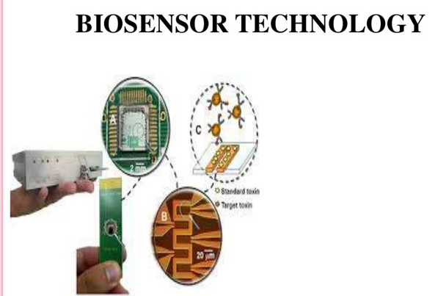

Slide 25
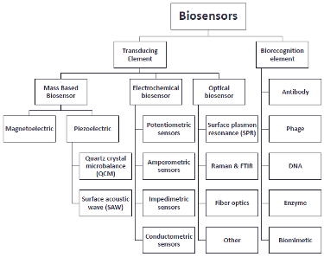
Based on transducer type, biosensor or sensors are classified as

Slide 26
Measures change in electrical potential
Measures current

Slide 27
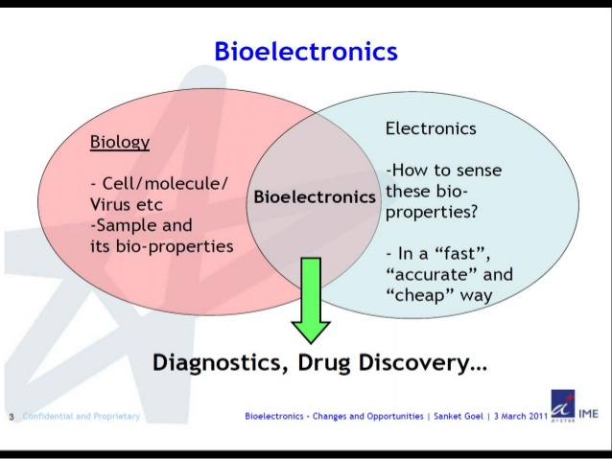

Slide 28
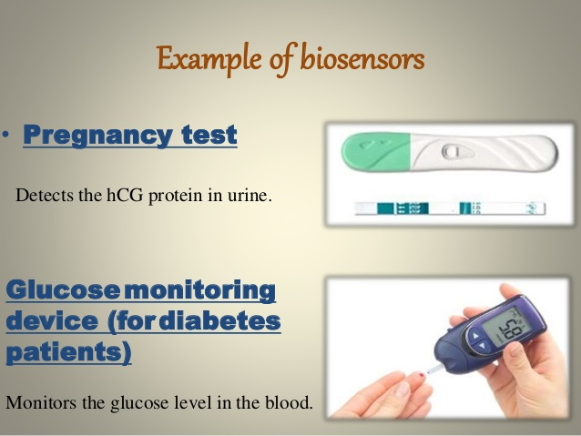

Slide 29
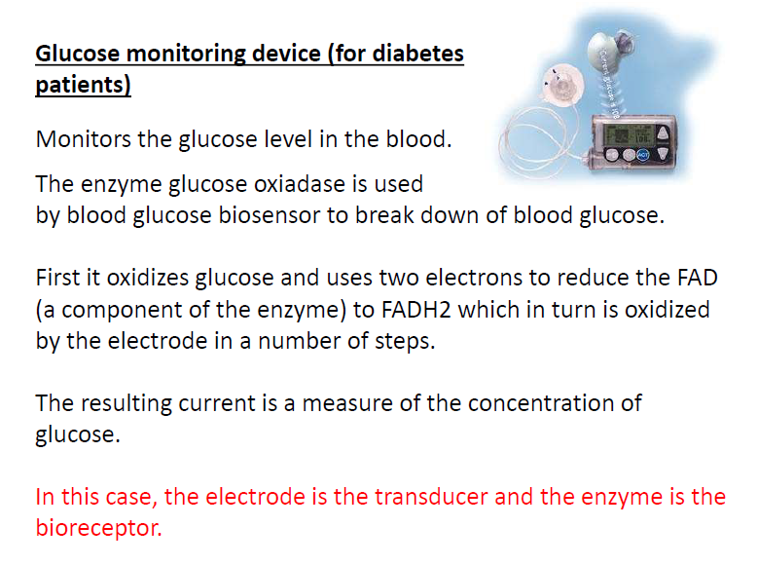

Slide 30
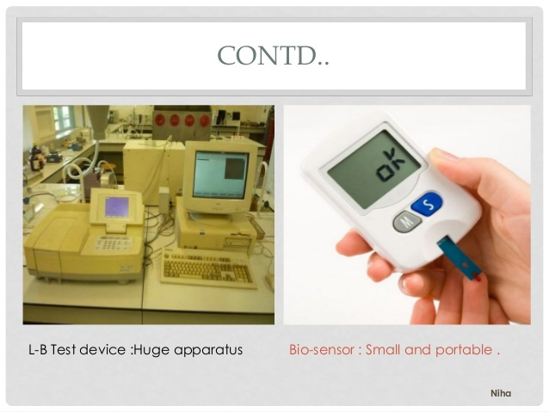
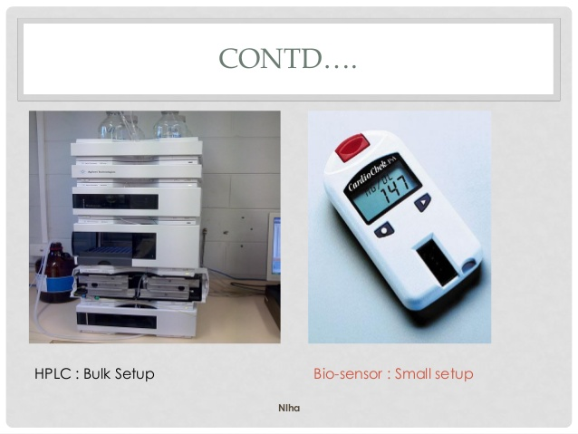
Cholesterol biosensor
Liebermann-burchard test…colorimetric test for cholesterol biosensor

Slide 31
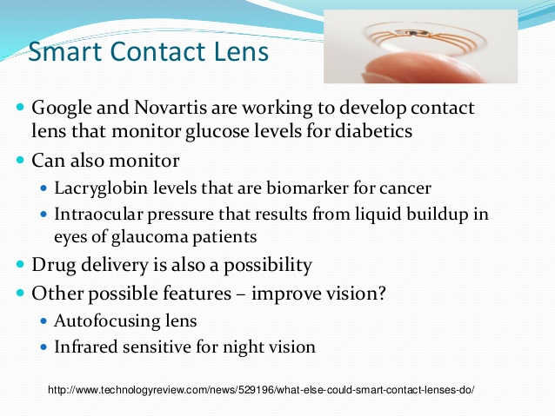

Slide 32
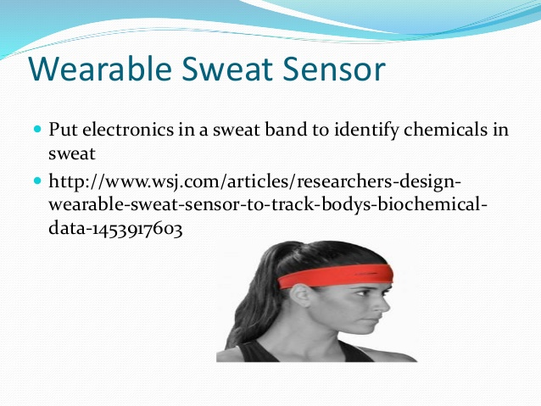

Slide 33
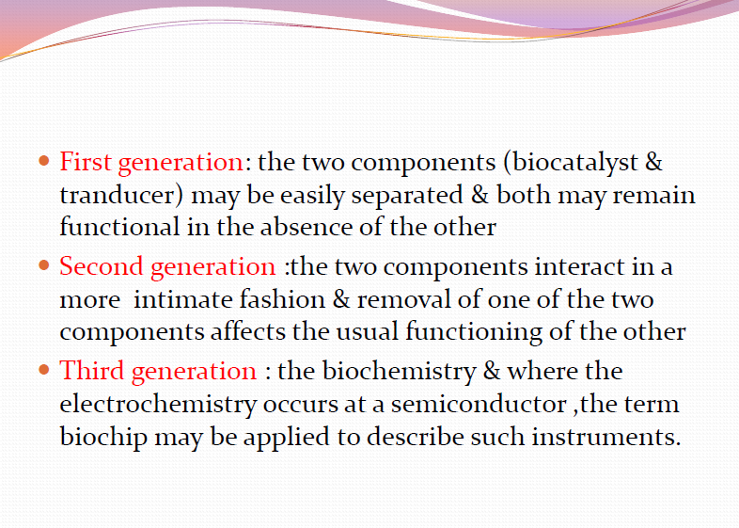

Slide 34
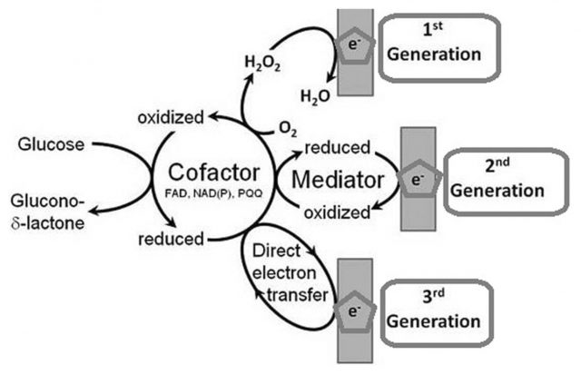

Slide 35
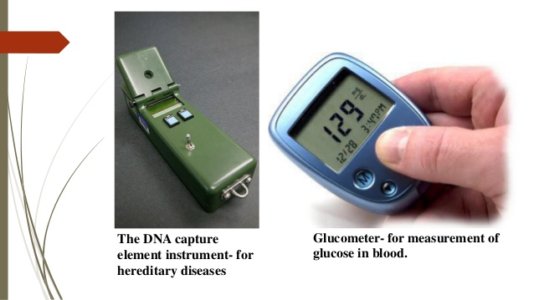

Slide 36
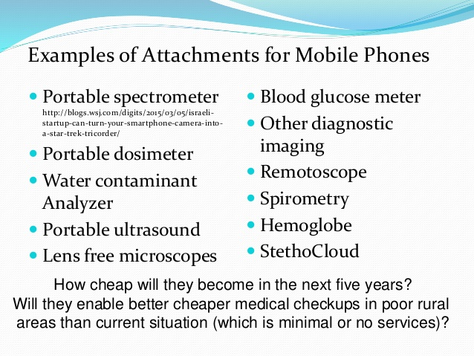
https://www.slideshare.net/Funk98/bioelectronics-biosensors-smart-phones-and-health-care

Slide 37
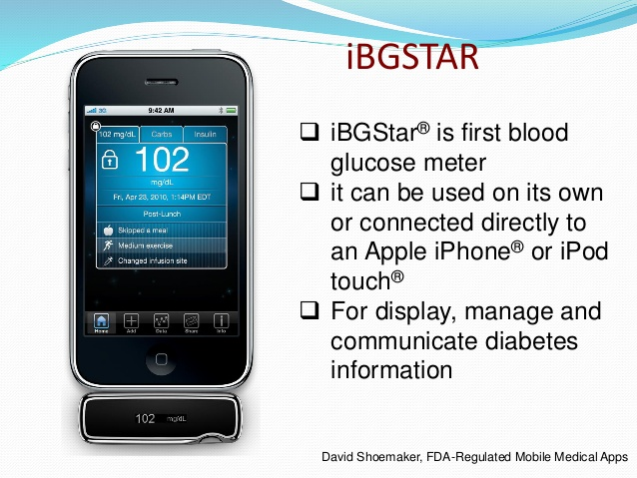

Slide 38
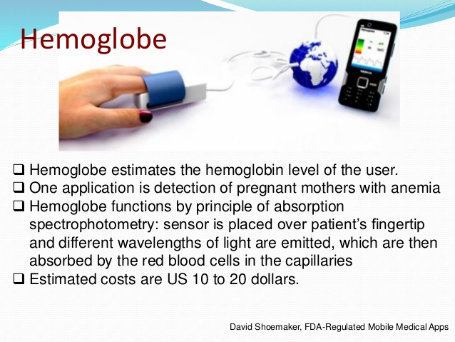

Slide 39
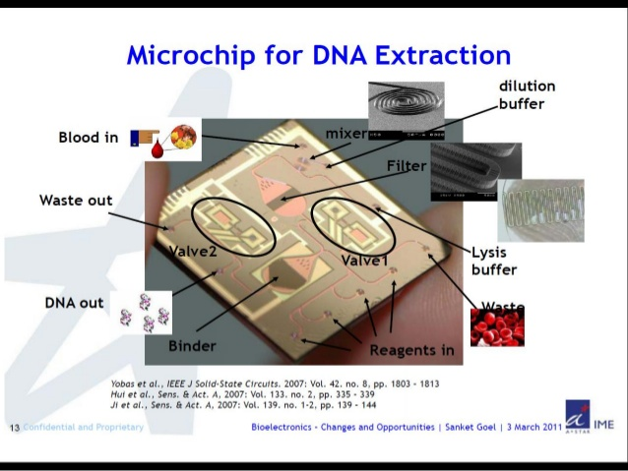

Slide 40
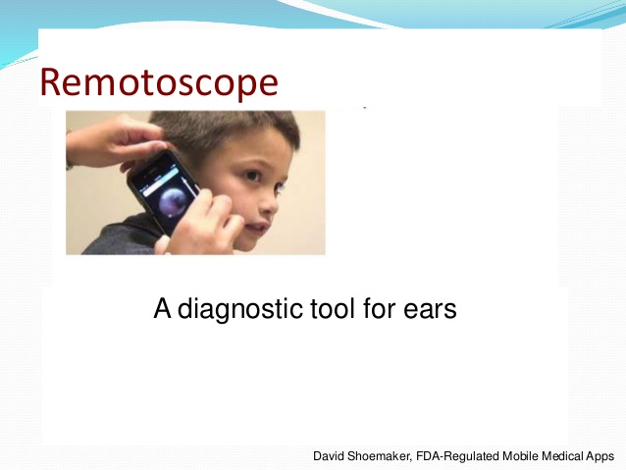

Slide 41
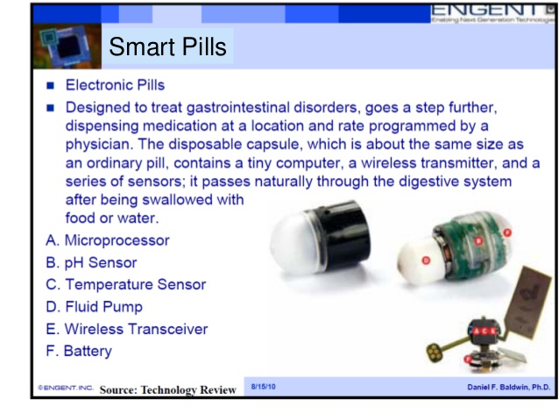

Slide 42
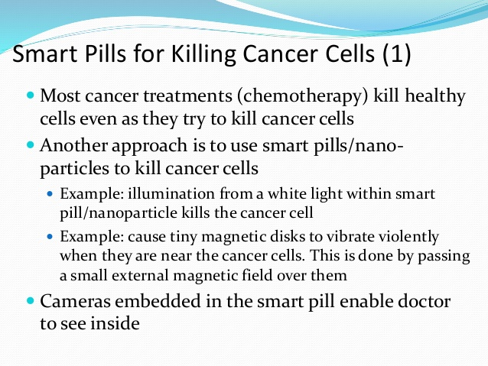

Slide 43
